Slide 1

Enterprise Search using speech via PocketSphinx
Roopesh Munnaluri
Advisor: Michael Jonas
Date: 12/11/2020

Slide 2
Objectives
Generating Language model
Testing Language Model
Develop an android application with the chosen GUI
Integrate PocketSphinx with android applications.

Slide 3
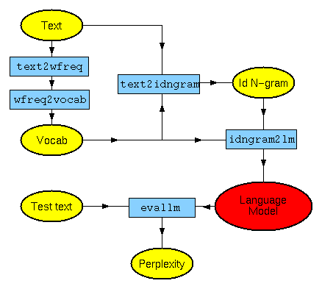
Approach
Framework
Tools:
Android Studio
CMU SLM toolkit
Dataset
A file with English transcripts.

Slide 4
Approach
Procedural Steps:
Generating frequency file
Generating Vocabulary file
Generating n-gram file
Generating language model
Generating binary Ngram language model file(DMP file)
Executing PocketSphinx in UNIX environment
Integrating with Android Studio

Slide 5
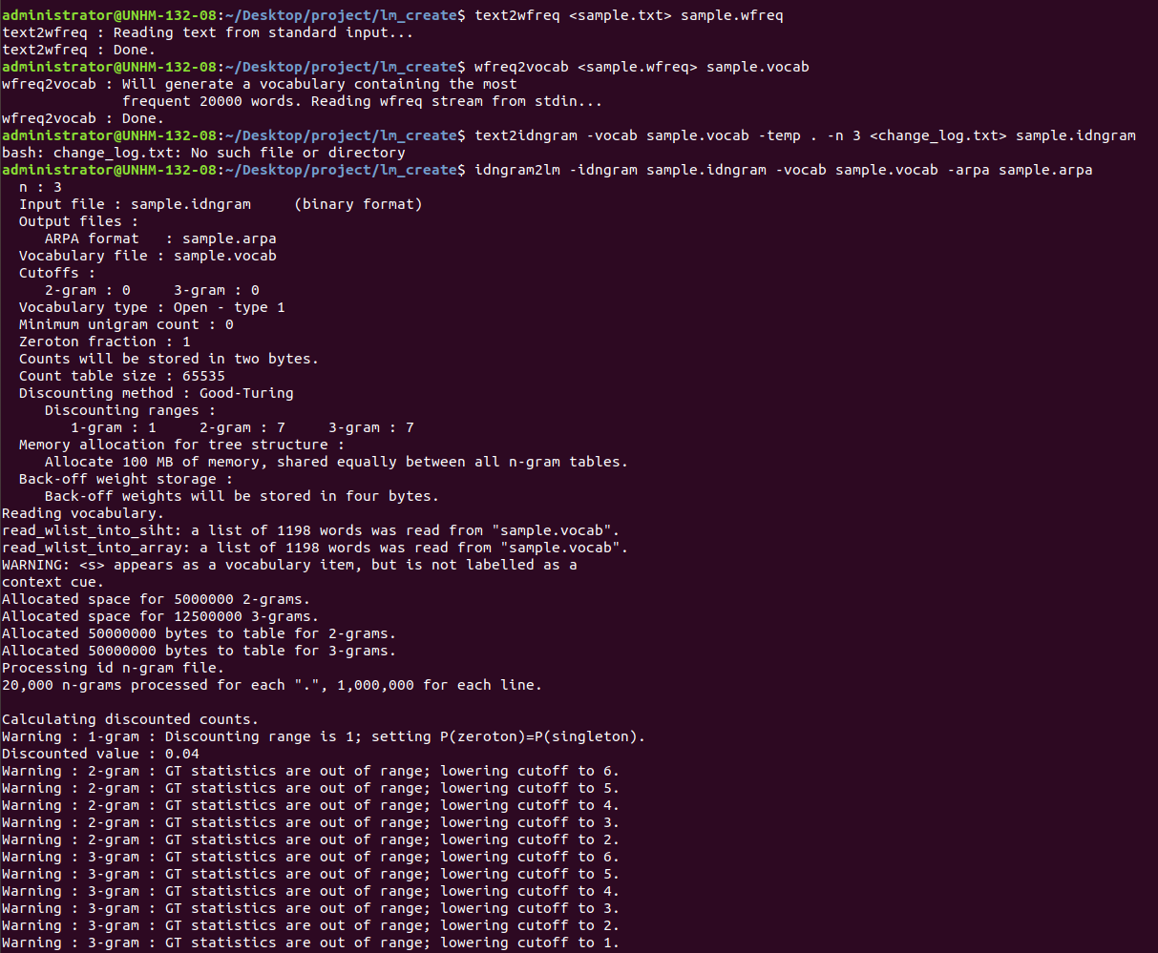
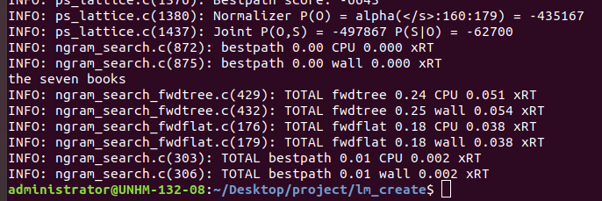
Results
Testing Language model
Generating Language Model

Slide 6
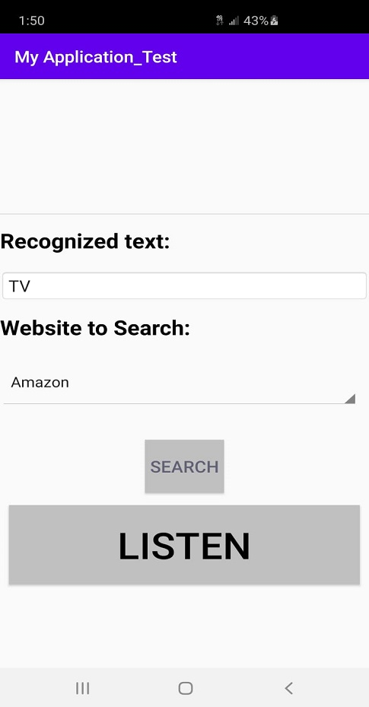
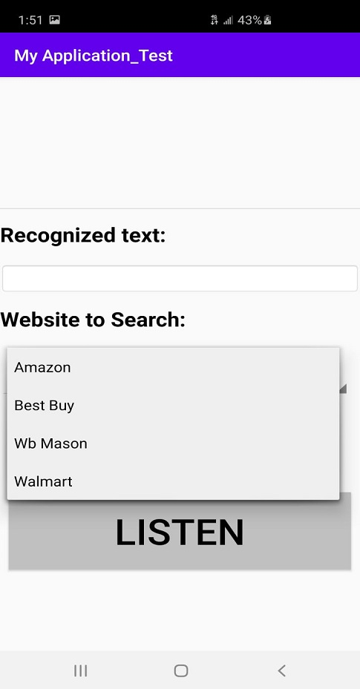
Results
Home Page
Choosing Enterprise

Slide 7
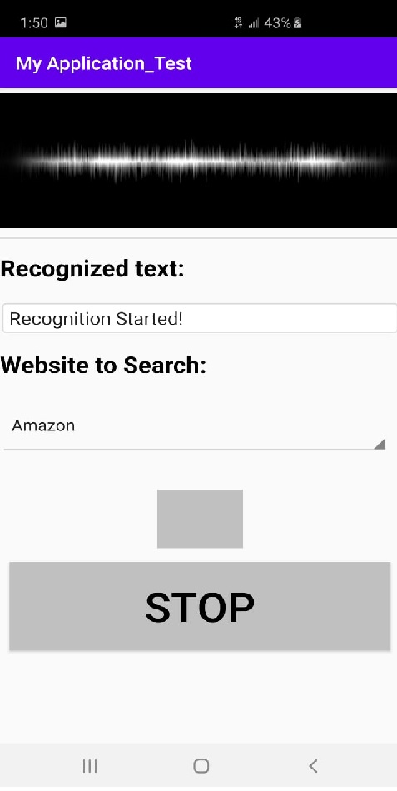
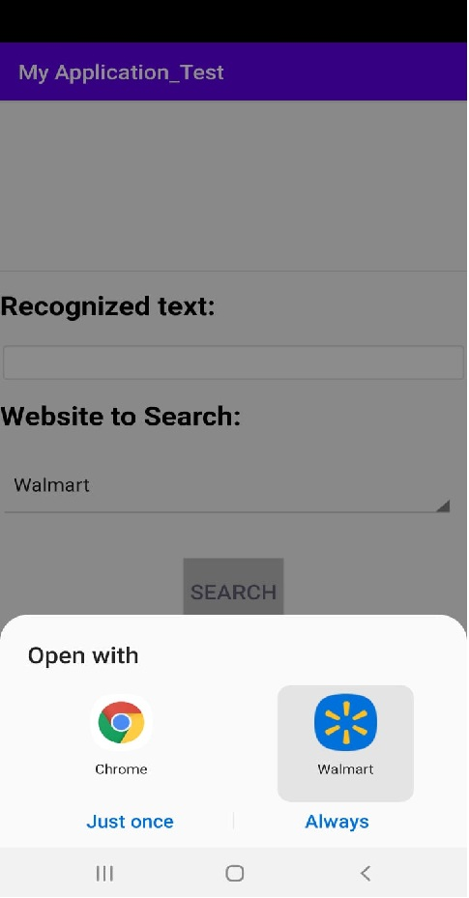
Results
Recognizing Text
Redirecting

Slide 8
Evaluation
Generated Language model
Tested Language Model
Developed an android application with the chosen GUI
Integrated PocketSphinx in the android applications.

